Slide 1


By
Dr. C.S. Jyothirmayee
CSIR Unit for Research And Development Of Information Products (URDIP)
Jopasana, 85/1, Near Vanaz Engg, Paud Road, Kothrud, Pune 411038
Email: jyothics@urdip.res.in
Indian Patent Act, 1970

Slide 2
What is patent?
A patent is a state grant in favor of the inventor conferring on him a right to use the invention to the exclusion of all others.
The fundamental Principle in awarding a patent is that the right must be granted for an invention, which has novelty and utility.
The extent of legal protection accorded to a patent is based upon the way the patent claim is drafted in the patent application.

Slide 3
HISTORY OF PATENT ACTS IN INDIA
1856 | Act for protection of inventions on the basis of British law of 1852
1859 | Patent monopolies called exclusive privileges (14 year)
1872 | Patents and Designs Act
1883 | Protection of Inventions Act
1888 | Inventions and Designs Act
1911-1947 | Modern patent era by Patents and Designs Act. First time an authority call Controller General of Patents appointed
1959 | Justice Ayyangar’s report
1967 | Patent Act bill introduced in the Parliament
1970 | The Patents Act passed by the parliament
1972 | The Patents Act-1970 came into force on April 20, 1972
1994 | Amendment by ordinance to include Exclusive Marketing Rights (EMR’s)
1999 | Amendment passed by the parliament. New patent amendment bill referred to select committee
2003 2005 | Patents Act 1970 with second amendment comes into force Patent Act 1970 (2005 Amendment) comes in to force from 1-1-2005

Slide 4
Law and Regulations
  The Patents Act, 1970 (as amended in 2005)
    The Patents Rules, 2003 (as amended in 2006)
Patents Act, 1970
  Amended in
    1999
    2002
    2005
Patents Rules, 2003
  Amended in
    2005
    2006

Slide 5
Patent Law - Salient Features
Both product and process patent provided
Term of patent – 20 years
Examination on request
Both pre-grant and post-grant opposition
Fast track mechanism for disposal of appeals
Provision for protection of bio-diversity and traditional knowledge
Publication of applications after 18 months with facility for early publication
Substantially reduced time-lines

Slide 6
Safeguards in the Patent Law
Compulsory license to ensure availability of drugs at reasonable prices
Provision to deal with public health emergency
Revocation of patent in public interest and also on security considerations

Slide 7
Invention
Invention means-
A new product or process involving
an Inventive Step and capable of Industrial application
An invention is considered to be new, if it does not form a part of the state of the art
Capable of industrial application means- invention is capable of being made or used in any kind of industry
Inventive Step means a feature of an invention that involves an technical advance as compared to the existing knowledge or having economic significance or both and that makes the invention not obvious to a person skilled in the art

Slide 8
Also:
• A criterion for the process patent is elaborated to chemical process:
Biochemical, Biotechnological and Microbiological processes.
• Scientists involved since long time in research and development in the field of genetics for creation of human clone baby holding genetically altered cell, are allowed to acquire the patent right on their worthy enormous effort.
• A method or process of testing during the process of manufacture is patentable.
• Process defined for the diagnostic and therapeutic treatment in case of plants is patentable.

Slide 9
NON-PATENTABLE INVENTIONS
There are some products and processes, which are not patentable in India. They are classified into two categories in the patent act
Those, which are not inventions
b) Invention relating to atomic Energy

Slide 10
An invention which is frivolous or which claims anything obvious contrary to well established natural laws.
2. An invention the primary or intended use or commercial exploitation of which could be contrary to public order or morality or which causes serious prejudice to human, animal or plant life or health or to the environment.
For example,
  Gambling machine, device for house-breaking,
  Biological warfare material or a device, WMD
  Onco- mouse case, embryonic stem cell
  Terminator gene technology,

Slide 11
3. Discovery adds to the human knowledge by
disclosing something ,not seen before, whereas,
Invention adds to human knowledge by suggesting an act to do which results in a new product or new process
e.g. Archimedes Principle, Superconducting Phenomenon etc as such – not patentable ,
However, An apparatus/method for technological application may be patentable
A property of certain material to withstand mechanical shock is not patentable,
but A claim to a railway-sleeper made of that material may be patentable

Slide 12
Discovery of a substance, freely occurring
in nature is not patentable
However, if that substance is first to be
isolated from its surrounding and a process for
obtaining it is developed , the process may be patentable
Discovery of micro-organism, Discovery of natural gas or a mineral, not patentable

Slide 13
4. The mere discovery of a new form of a known substance which does not result in the enhancement of the known efficacy of that substance or the mere discovery of any new property or new use for a known substance or of the mere use of a known process, machine or apparatus unless such known process results in a new product or employs at least one new reactant.
The mere discovery of a new form of a known substance which does not result in the enhancement of the known efficacy of that substance
OR
the mere discovery of any new property or new use for a known substance
OR
of the mere use of a known process, machine or apparatus, unless such known process results in a new product or employs at least one new reactant.

Slide 14
For the purposes of this clause,
salts, esters, ethers, polymorphs, metabolites,
pure form, particle size, isomers, mixture of isomers, complexes, combinations, and other derivatives of known substances shall be considered to be the same substance,
unless they differ significantly in properties with regard to efficacy.
eg. New use of Aspirin in heart ailments,
Mere new uses of Neem

Slide 15
5. A substance obtained by a mere admixture resulting only in the
aggregation of the properties of the components thereof or a process for producing such substance.
For example: Not patentable-
1) Paracetamol (Antipyretic) +Brufen (analgesic)
= A drug (antipyretic & analgesic)
2) A mixture of sugar and some colorants in water to
produce a soft drink is mere admixture
But, a mixture resulting into synergistic properties of mixture of ingredients however, may be patentable
e.g Soap, Detergents,lubricants etc
6. The mere arrangement or re-arrangement or duplication of known devices each functioning independently of one another in a known way.

Slide 16
7. A method of agriculture or horticulture.
8. Any process for the medicinal, surgical, curative, prophylactic diagnostic therapeutic or other treatment of human being or any process for a similar treatment of animals to render them free of disease or to increase their economic value or that of their products.
For example:
Removal of cancer tumor
Removal of dental plaque and carries,
Surgical processes, any process relating to therapy,
Method of vaccination,
Method of therapy carried out on materials temporarily removed from the body for example, blood transfusion,
However ,
Method performed on tissues or fluids permanently removed from the body
Surgical,therapeutic or diagnostic Apparatus or instrument
are not excluded from patentability

Slide 17
9. Plants and animals in whole or any part thereof other than microorganisms but including seeds, varieties and species and essentially biological processes for production or propagation of plants and animals.
For example,Clones and new varieties of plants: Not patentable
Microorganisms, per se: Not patentable,
If human intervention in the process plays a significant role- not an essentially biological process
A process for the production of plants or animals if it consists entirely of natural phenomena such as crossing or selection”- essentially biological

Slide 18
10. A literary, dramatic, musical or artistic work or any other aesthetic creation whatsoever including cinematographic works and television productions.
11. A mere scheme or rule or method of performing mental act or method of playing game.
12. A presentation of information.
13. Topography of integrated circuits
14. Computer programs
15. Replication of any traditional knowledge.
An invention which, in effect, is the Traditional Knowledge or an aggregation or duplication of known properties of traditionally known component or components

Slide 19
Unity of Invention- related inventions could be claimed in one application
No patents related to Atomic Energy (Sec. 4)

Slide 20
Single Inventive Concept
A single invention or group of inventions , linked so as to form a single inventive concept
Single inventive concept may give rise to number of independent claims in the same or different categories
Where a group of inventions is claimed in one application, the requirement of Unity of Invention is fulfilled only when there is a technical relationship among those inventions
The common Single technical feature must be inventive enough to fulfill the requirement of non-obviousness

Slide 21
TYPES OF PATENT APPLICATIONS
A. Ordinary Patent Application
It is a simple application for patent without any priority claim and not being convention or National Phase Application. It should be accompanied by a provisional or complete specification at the time of filing.
B. Convention Application
An applicant who files an application (.basic application.) for patent in a convention country can make convention application in India within 12 months from the date of basic application.

Slide 22
C. National Phase Application under PCT
PCT stands for the Patent Co-operation Treaty. It is a sister treaty of the Paris Convention administered by the World Intellectual Property Organization (WIPO).
The PCT system facilitates filing of patent applications under a single umbrella and provides for simplified procedure for the search and examination of such applications.
This allows a resident or national of a PCT member state to obtain
the effect of patent filings in any or all of the PCT countries and to defer the bulk of filing costs usually due on filing.
India became a PCT Contracting state on December 7, 1998.

Slide 23
PERSONS ENTITLED TO APPLY FOR PATENT IN INDIA
An application for a patent for an invention may be made by any of the following persons either alone or jointly with another
True and first Inventor
b) His/her assignee
c) Legal representative of deceased inventor or assignee.

Slide 24
CHECK-LIST AND INFORMATION REQUIRED FOR FILING PATENT
Name, Nationality and Address of the applicant
2. Name, Nationality and Address of the inventor
3. Title, Description, Drawings, Claims & Abstract of the Invention
4. FORM 1- Application for patent to be filed in duplicate
5. FORM 2- Description, Drawings, Claims and abstracts in duplicate
6. FORM 3- Statement and undertaking regarding foreign filing details in
respect of the same invention

Slide 25
9. FORM 5- Declaration as to Inventor-ship
10. Priority document (if applicable)
11. FORM 26- Power of Attorney (can be filed later, before hearing)
12. Proof of right if the application is made by the assignee or by way of separate assignment deed.(proof of right may be submitted within three months of application)

Slide 26
Stages from filing to grant of a patent

Slide 27
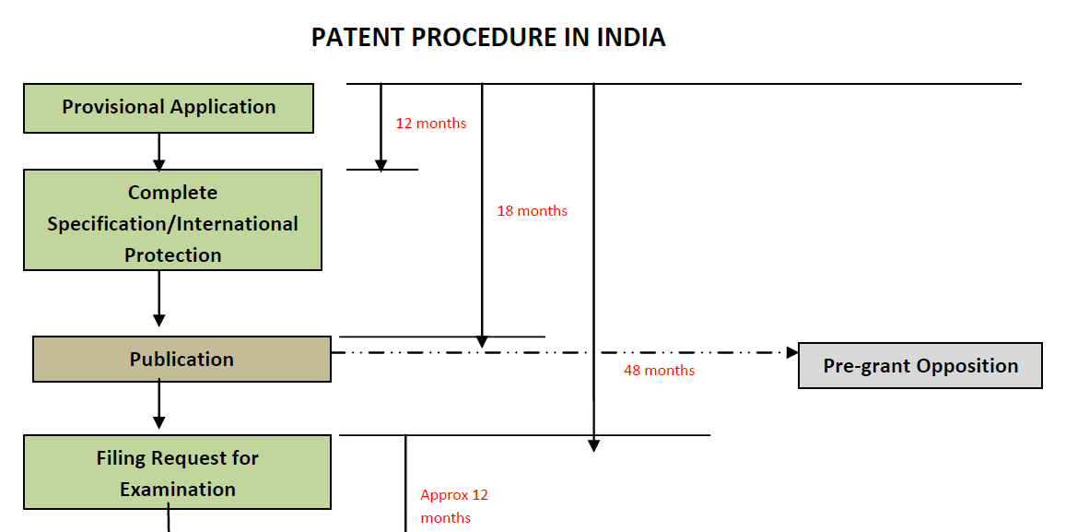

Slide 28
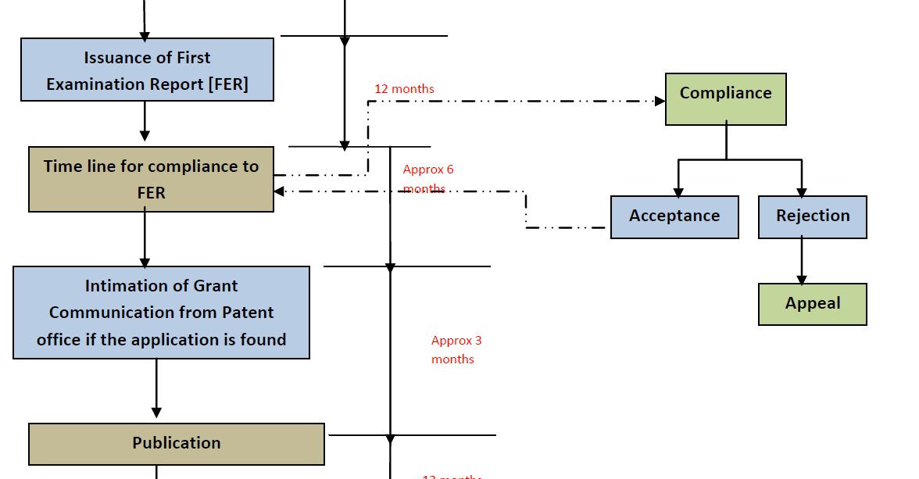

Slide 29
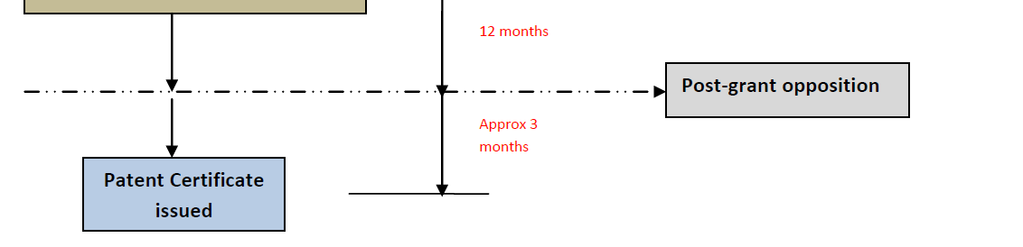

Slide 30

THANKS!

